Slide 1
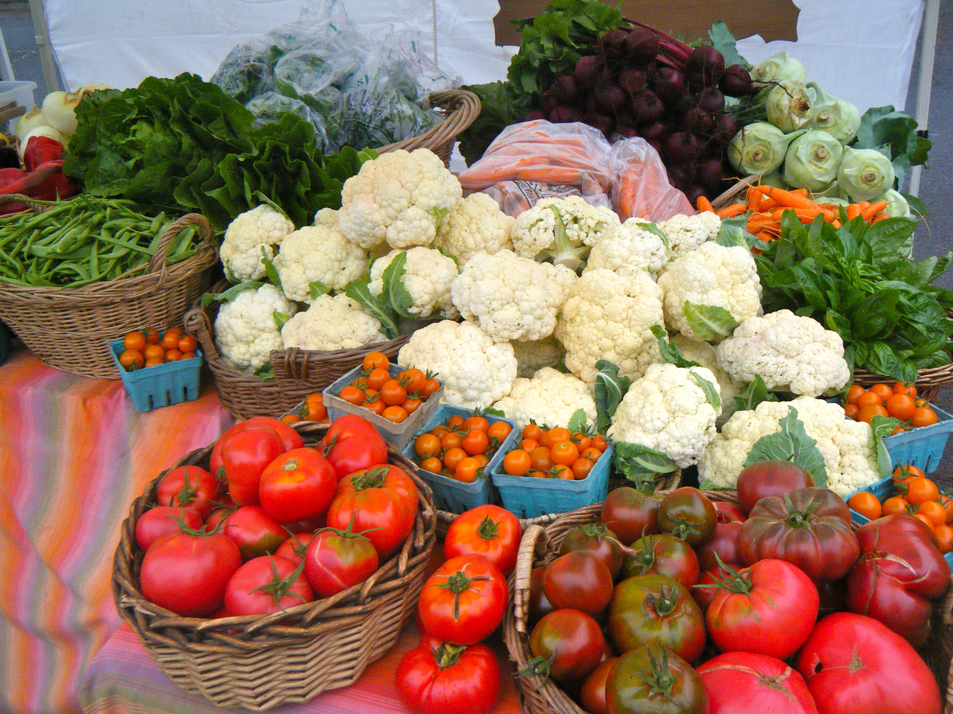
Growing Healthy Soil
Carolina Lees
Corvus Landing Farm
Neskowin, OR
carolina@corvuslanding.com
corvuslanding.com

Slide 2
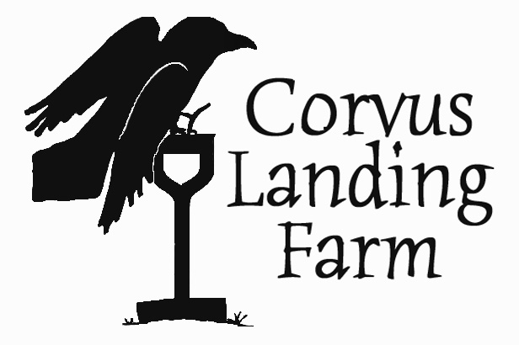
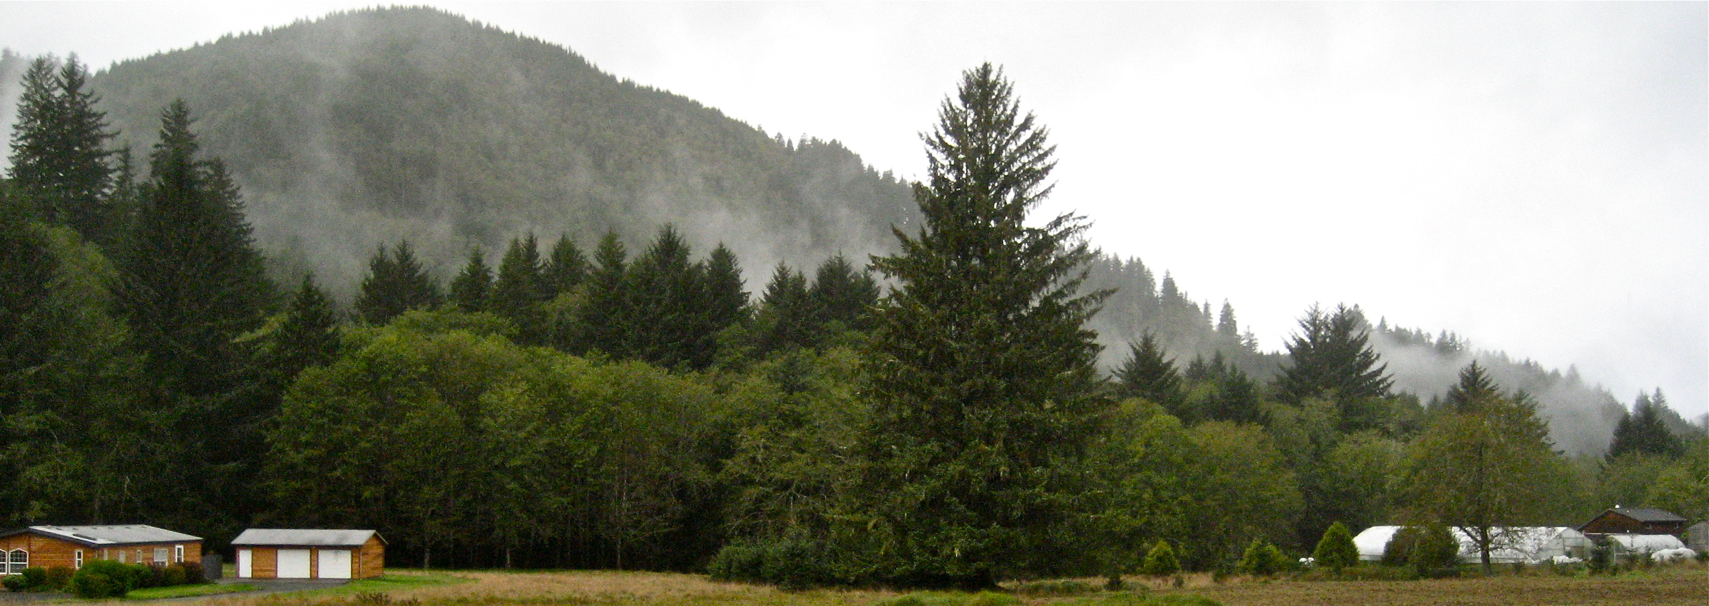
About me
Working in agriculture in the coast range since 2003
Founded Corvus Landing Farm in Neskowin in 2010
1 acre in production, with around 30 vegetable crops, 4000 ft² of greenhouse space, and a small nursery operation
We use all organic (uncertified) practices
Focus on cover cropping, variety selection, and soil building

Slide 3
Healthy soil means healthy plants means healthy people.
Soil science basics
Evaluation techniques
Strategies for soil maintenance and improvement

Slide 4
What defines your soil?
Mineral content (history)
Structure
Organic Matter
Biology
Nutritional content (Chemistry)

Slide 5
Mineral and Geological Makeup

Slide 6
How can you tell?
Observation:
Climate
Watershed
Native Vegetation
Dig around
Slope and Topography
NRCS Soil Maps
(http://websoilsurvey.sc.egov.usda.gov/App/HomePage.htm)

Slide 7
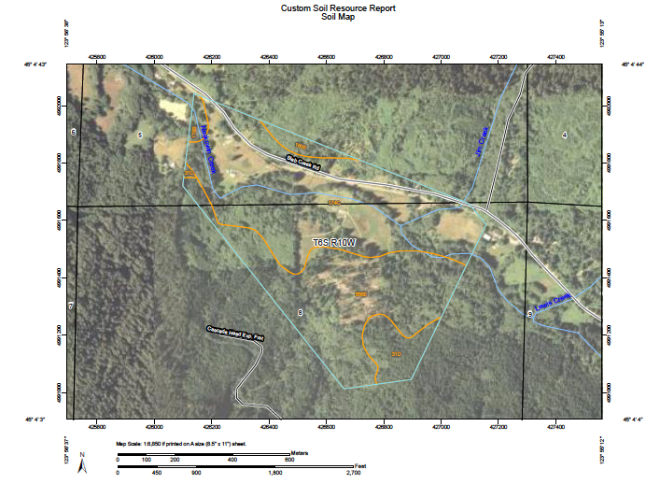

Slide 8
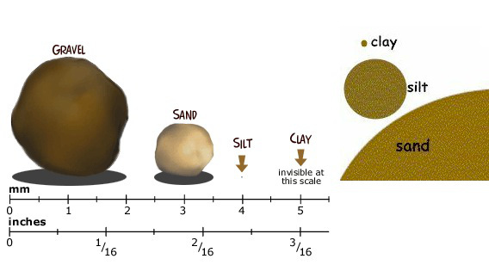
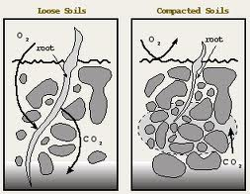
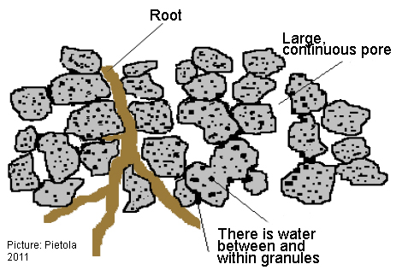
Soil Structure
https://deepfriedhoodsiecups .wordpress.com/2011/04/21/dfhc-4212011/
http://www.balticdeal.eu/measure/maintaining-good-soil-structure/
http://www.claydoctor.com/

Slide 9
How can you tell?
Take a handful of soil:
Or dig a hole:

Slide 10
Soil and Water Conservation Society (SWCS). 2000. Soil Biology Primer. Rev. ed. Ankeny, IA: Soil and Water Conservation Society.

Slide 11
Organic Matter and Humus
Organic Matter is food for your soil’s biology
Humus is its product

Slide 12
Organic Matter

Slide 13
Nutritional Content and Chemistry
Notes:
Origin of wave

Slide 14
Nutrition

Slide 15
How can you tell?
Take a soil test or plant tissue analysis, observation

Slide 16
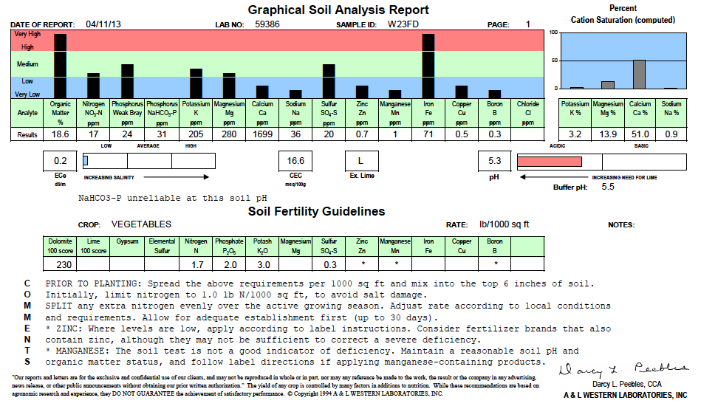
Soil Test 4/13

Slide 17
What we do at Corvus Landing: a coastal example

Slide 18
What does your soil structure need?

Slide 19
Remember to ask:

Slide 20
Resources
The Soul of Soil: A Guide to Ecological Soil Management
Grace Gershuny and Joseph Smillie
Building Soils for Better Crops
Fred Magdoff and Harold Van Es
Soil Biology Primer
Soil and Water Conservation Society
Growing Vegetables West of the Cascades
Steve Solomon
NRCS
http://nrcs.usda.gov
ATTRA
http://attra.ncat.org
OSU Small Farms and Extension: various publications
OSU Cover Crop and Fertilizer Calculator:
http://smallfarms.oregonstate.edu/node/54

Slide 21
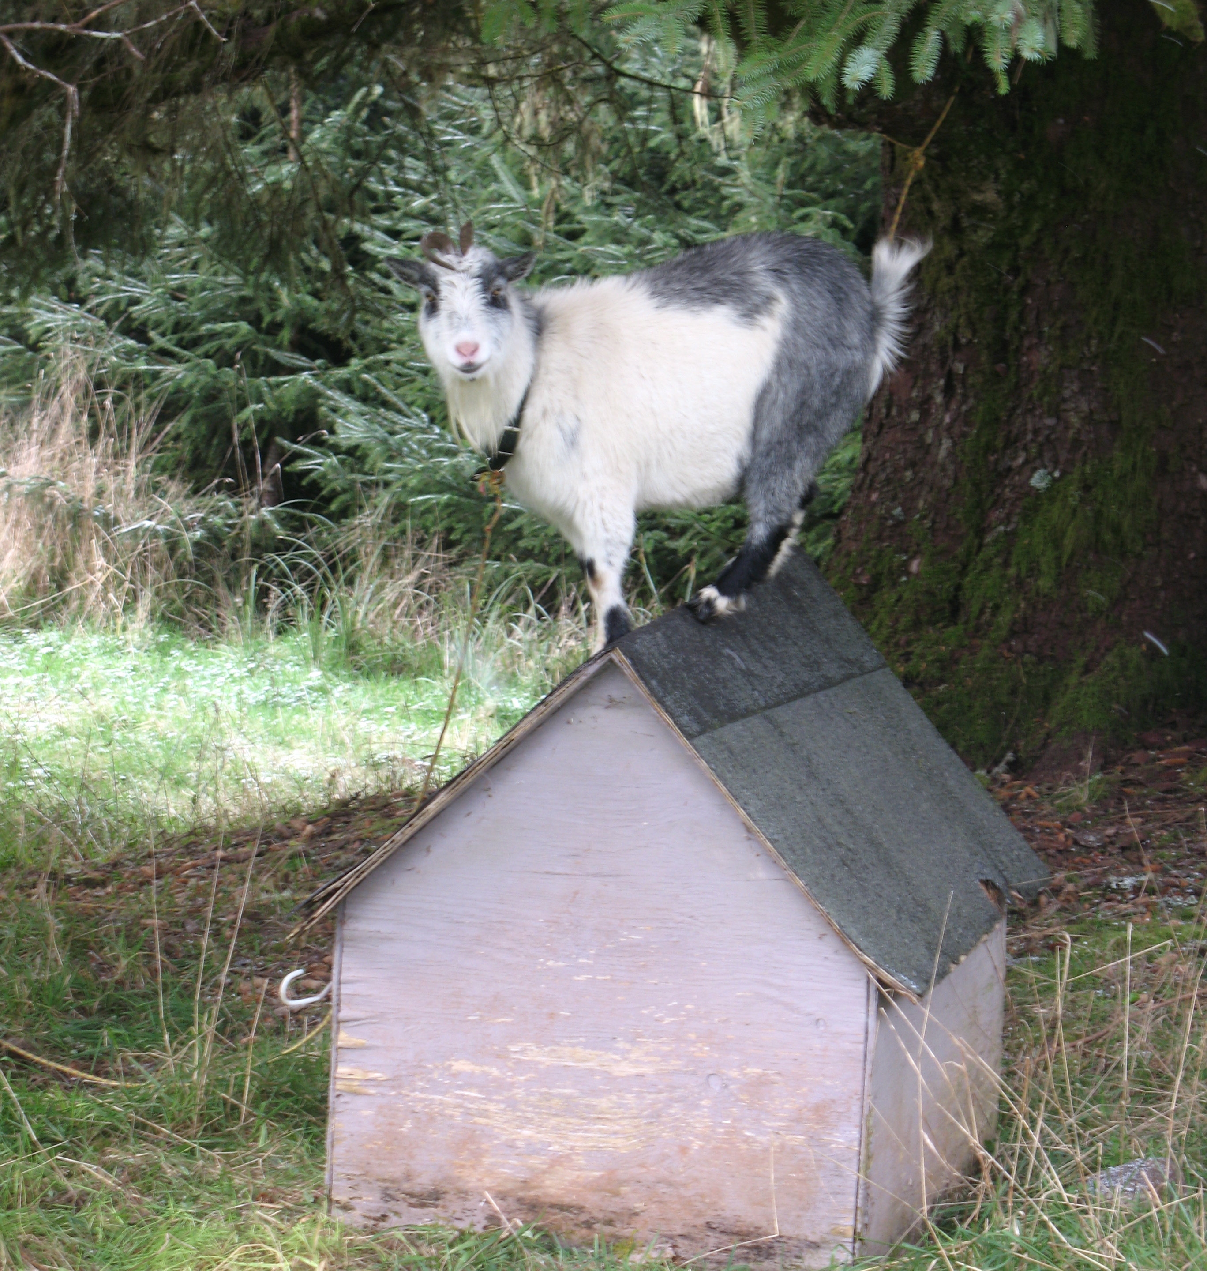
Growing Healthy Soil
Carolina Lees
Corvus Landing Farm
Neskowin, OR
carolina@corvuslanding.com
corvuslanding.com

