Slide 1
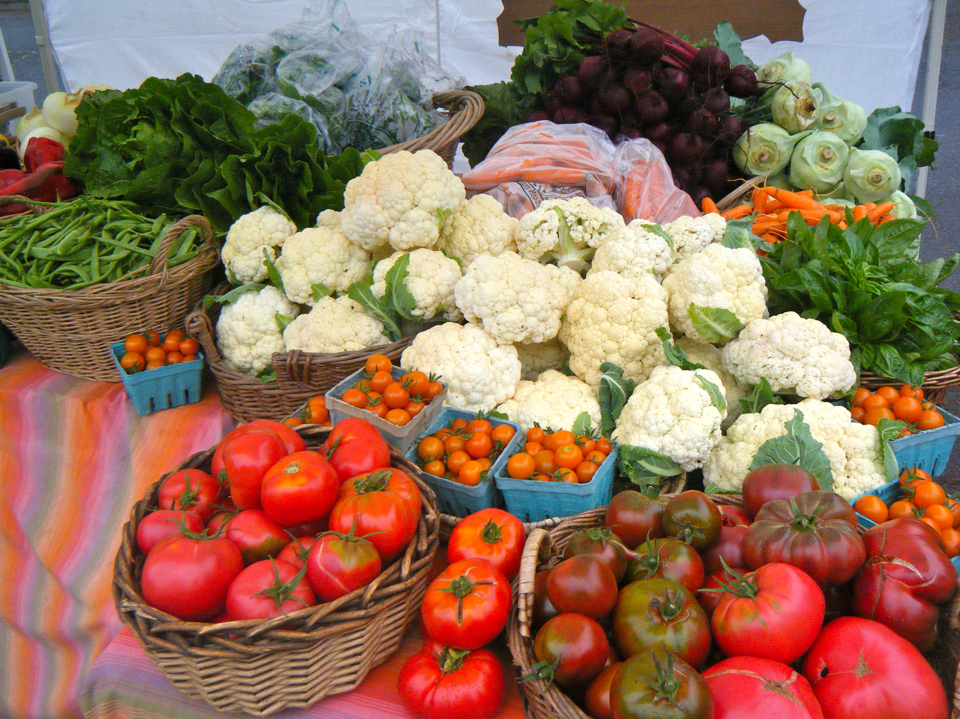
Planning Strategies for Plant Health
Carolina Lees
Corvus Landing Farm
Neskowin, OR
carolina@corvuslanding.com
corvuslanding.com

Slide 2
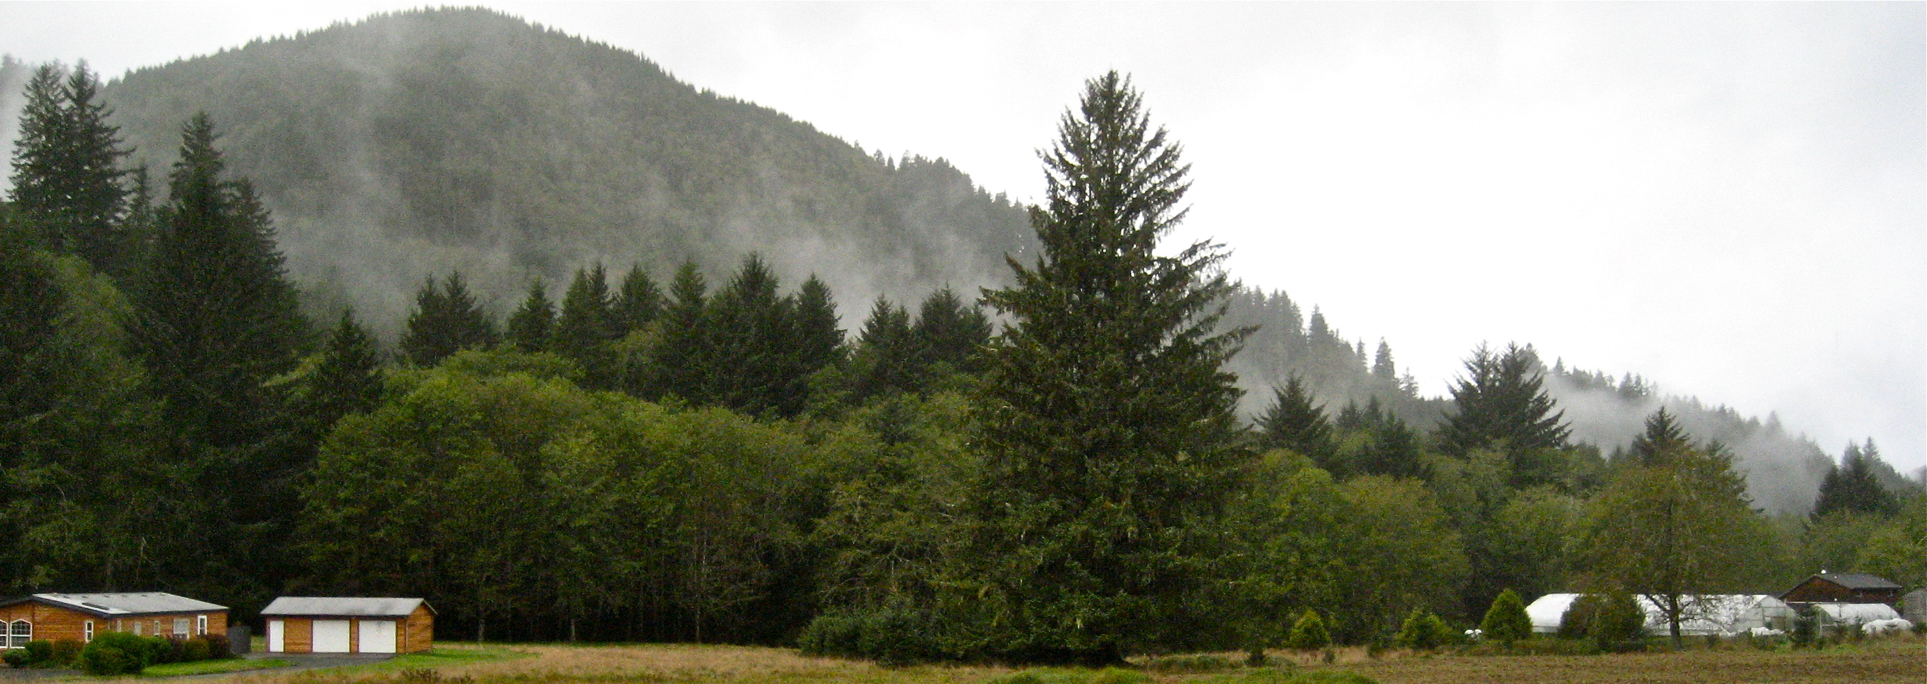
About the Farm
Started in 2010
1 acre in production, with around 30 vegetable crops, 4000 ft² of greenhouse space, and a small nursery operation
We use all organic (uncertified) practices
Focus on cover cropping, variety selection, and soil building

Slide 3
Healthy soil means healthy plants means healthy people. Ride the wave.

Slide 4
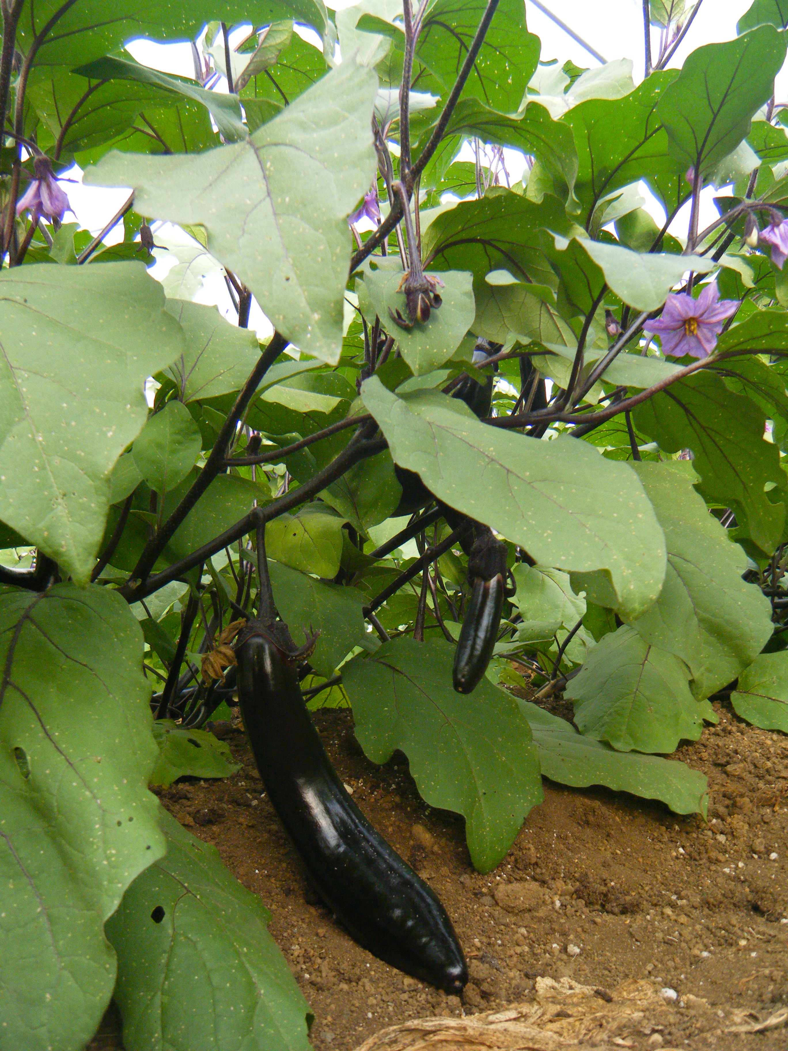
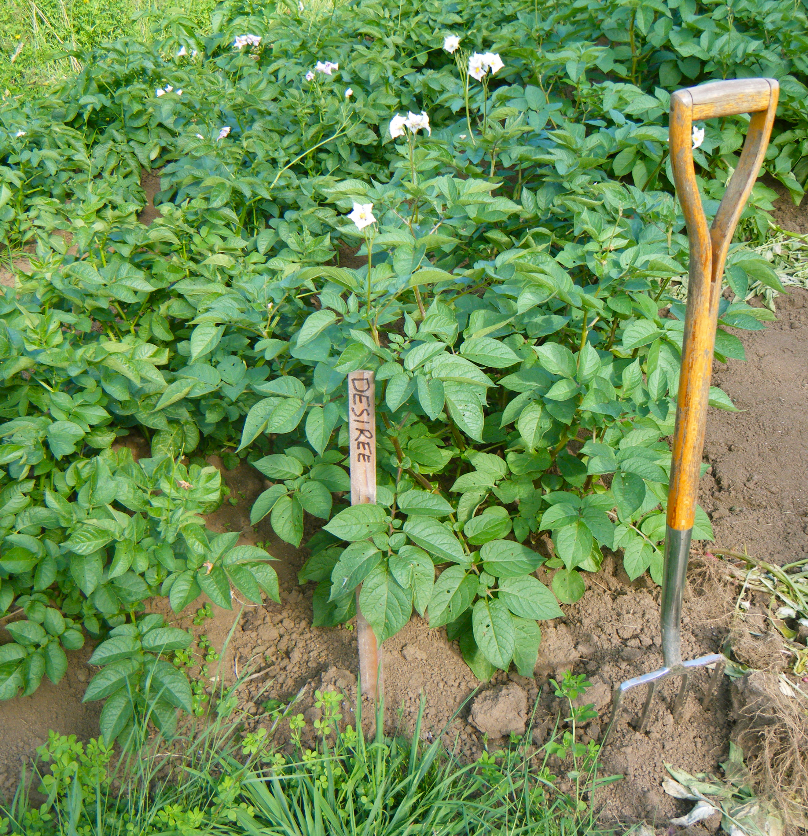
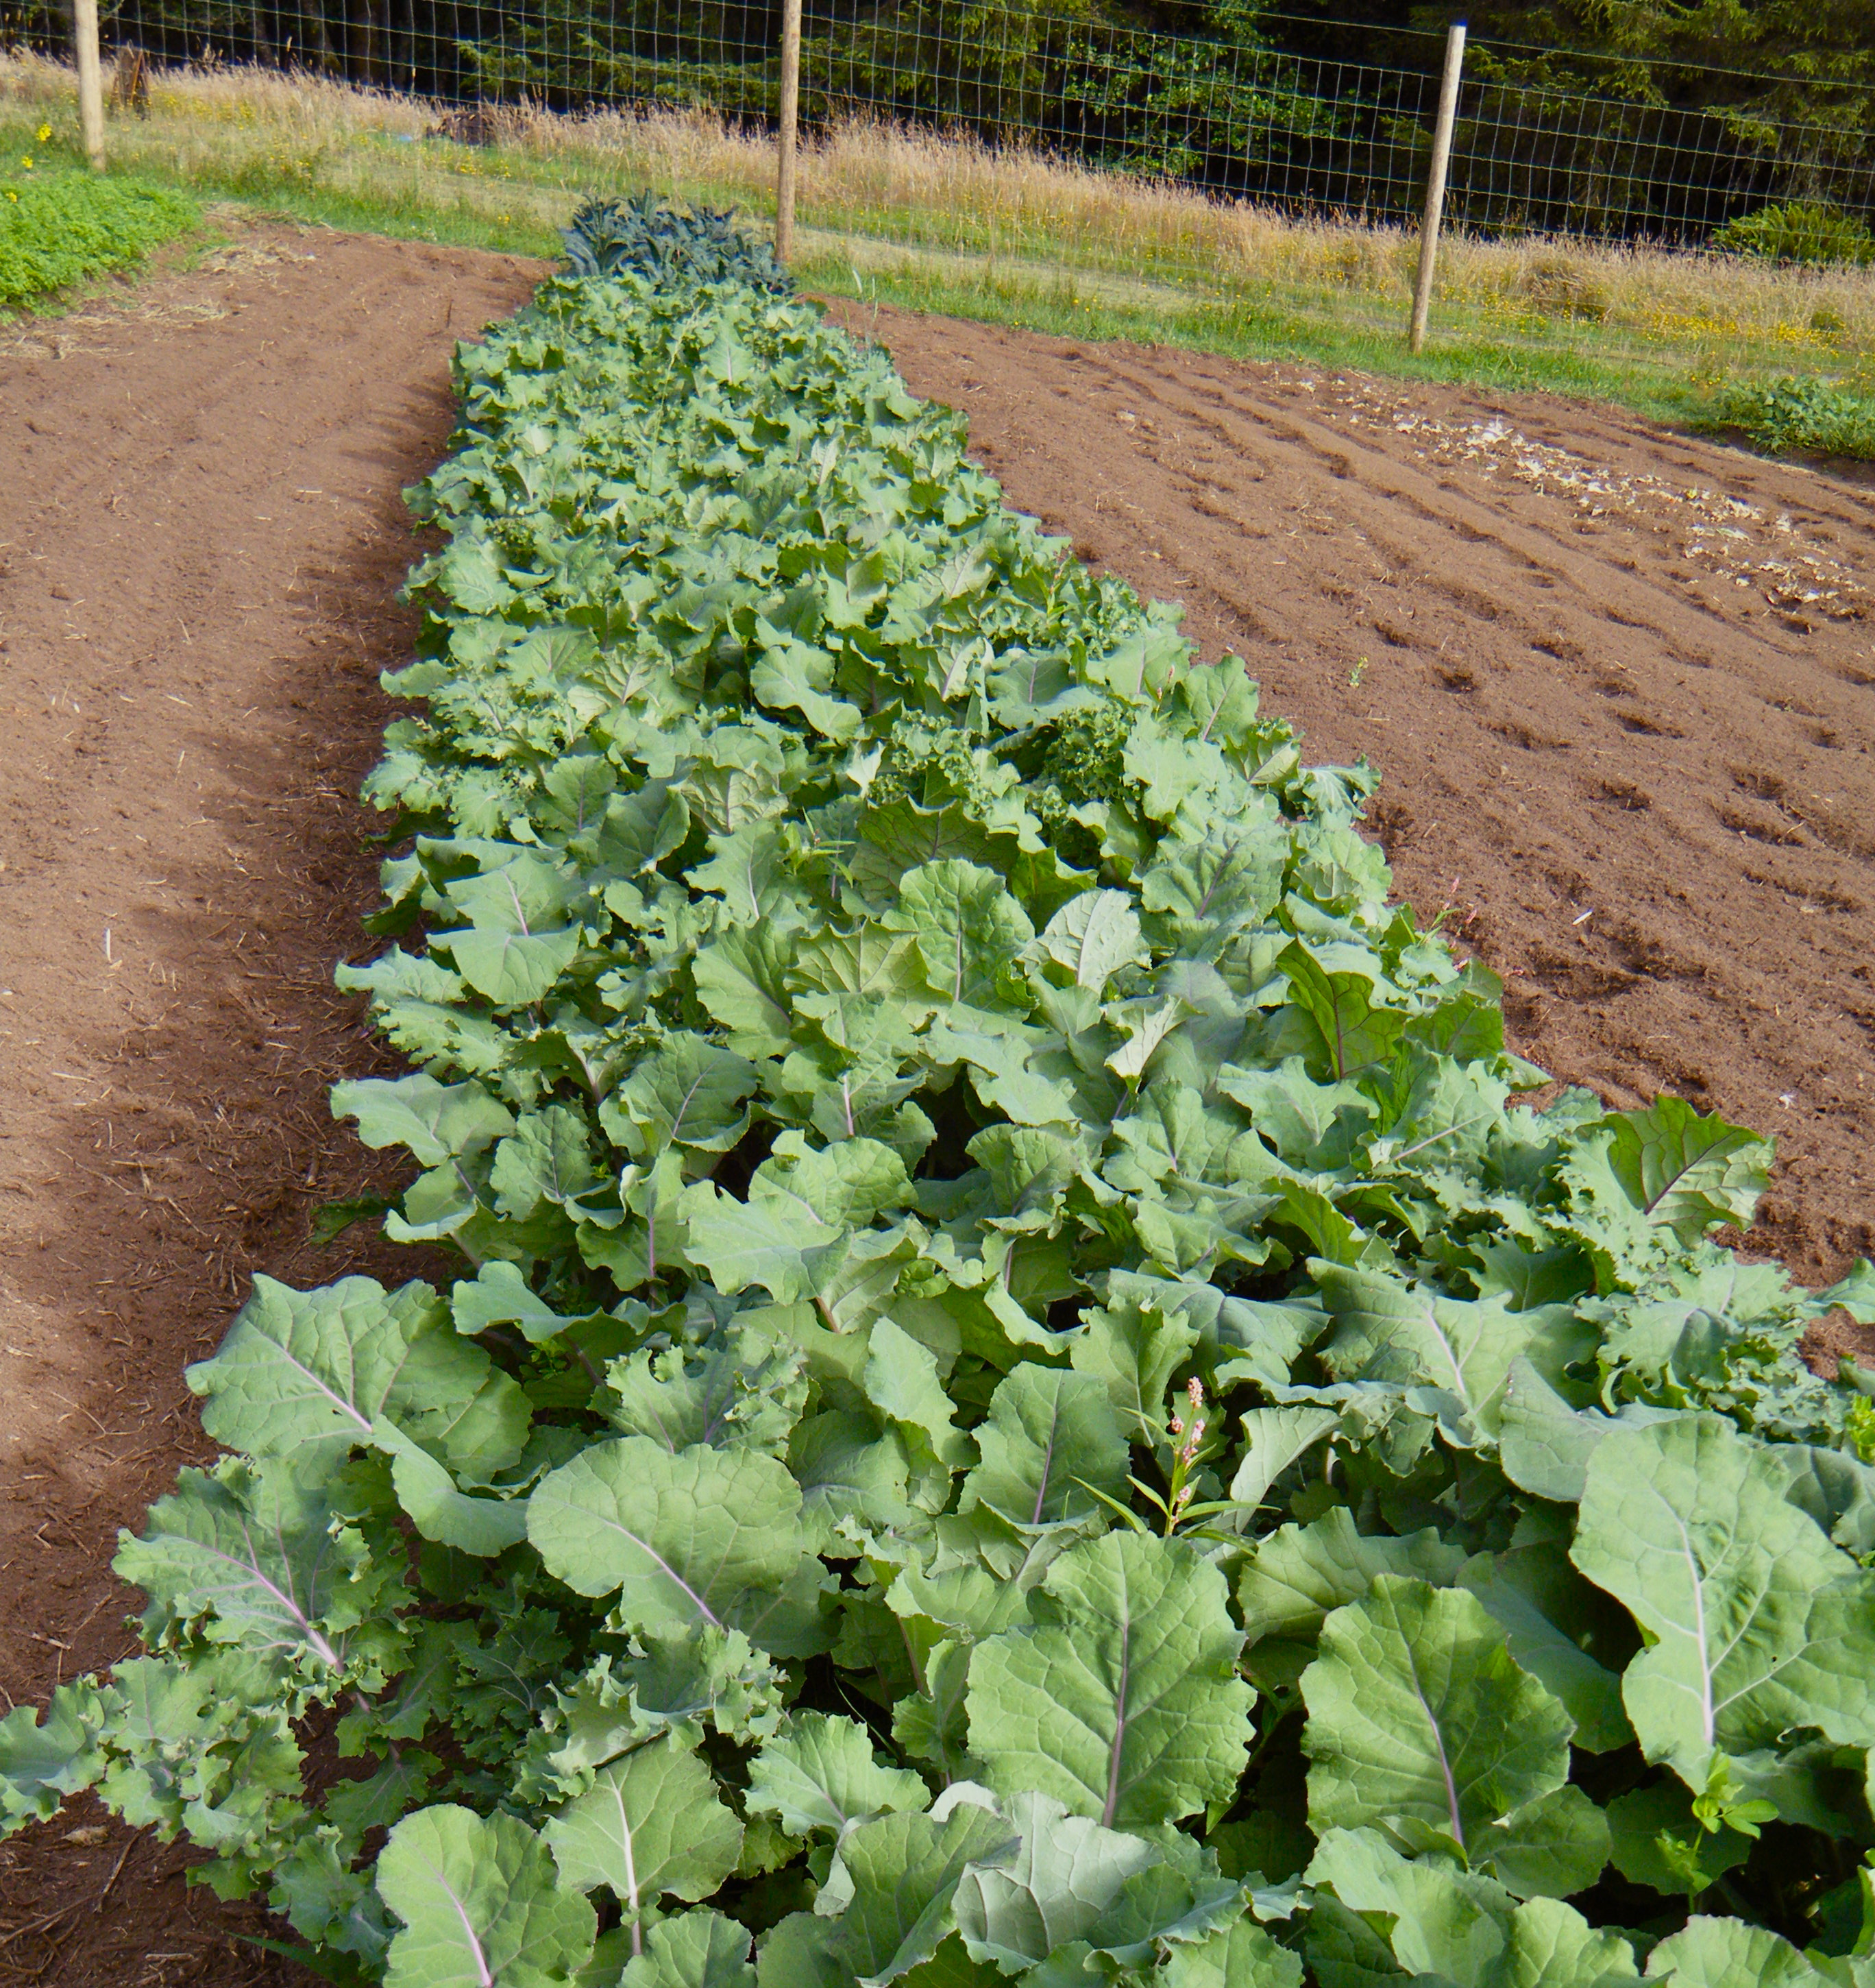
The wave breaks at different times for different plants:
Leaves
Roots
Fruits

Slide 5
What are the factors that contribute to plant health?
Nutrition
Climate conditions
Competition
Water

Slide 6
What can we control?

Slide 7
What strategies can we use?
Notes:
Talk about picture

Slide 8
Transplants: Give crops a head start
Notes:
Origin of wave

Slide 9
Nutrition

Slide 10
Spacing: a case of diminishing returns

Slide 11
Timing: the fourth dimension
So you have fertile soil and an efficient irrigation system. You can go ahead and plant whenever you want, right?

Slide 12
Um, no.
Cold soils have limited nutrient availability.
It is important to not plant too early or too late.
So how do you know when is the right time?
How do you get steady yields throughout the season?

Slide 13
Remember, timing is critical for cover crops too!
We start sowing in late August (earlier for intercropped crimson clover). We try to have it all sown by October 1.

Slide 14
Variety Selection
Plant what wants to grow, when it wants to grow

Slide 15
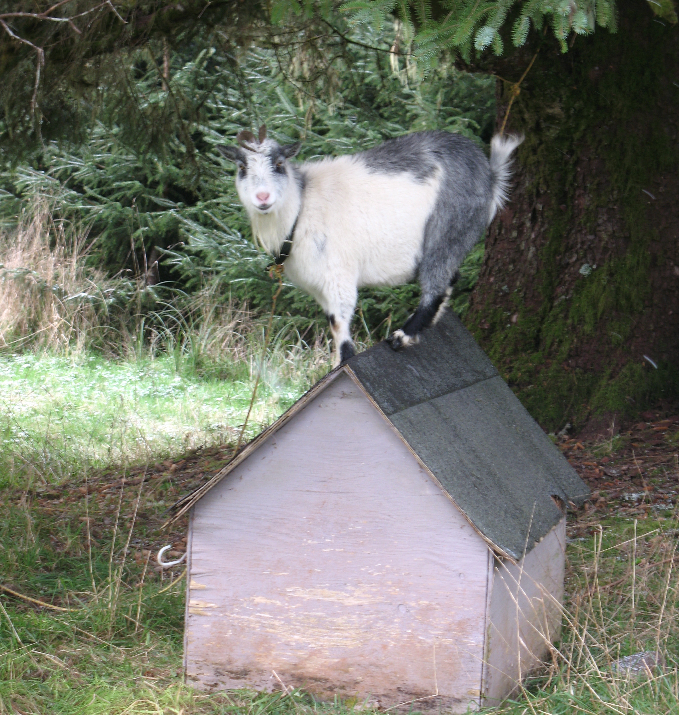
Planning Strategies for Plant Health
Carolina Lees
Corvus Landing Farm
Neskowin, OR
carolina@corvuslanding.com
corvuslanding.com

